Slide 1
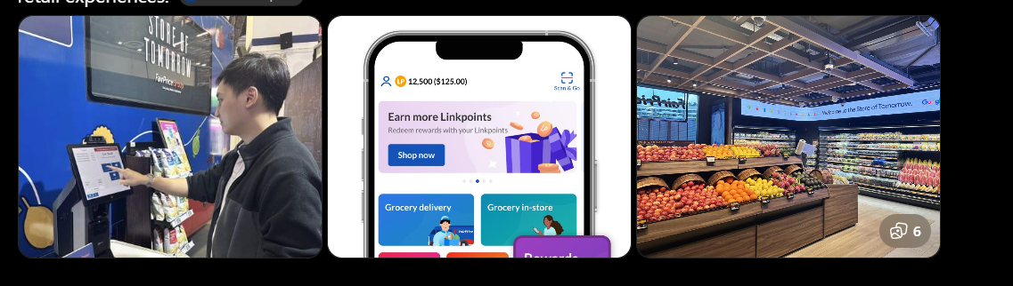
LO1 Activity – Digital Business Concepts
A strong Singapore enterprise for this activity is NTUC FairPrice / FairPrice Group. It is especially suitable because it has evolved from a traditional supermarket retailer into an omnichannel digital business ecosystem involving online shopping, mobile payments, loyalty, dining, partners, AI, retail media, and data-driven services. FairPrice reports that its app is used across FairPrice stores, Kopitiam, Cheers and Unity, while its newer “Store of Tomorrow” programme includes AI-enabled operations, smart carts and digital-physical retail experiences

Slide 2
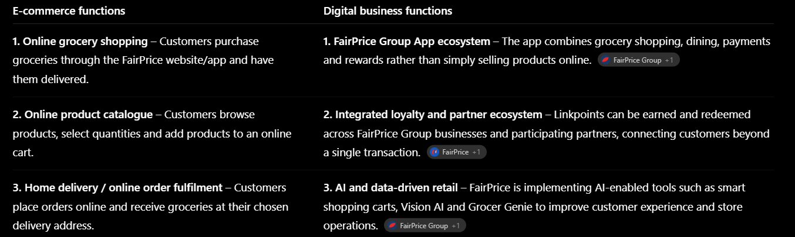
LO1 Activity – Digital Business Concepts

Slide 3
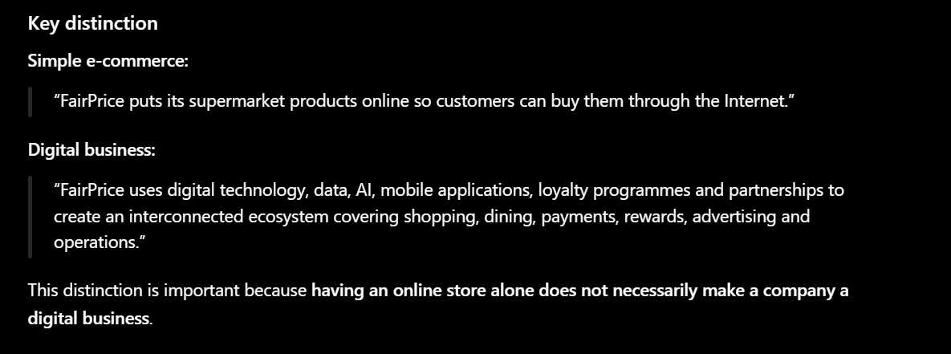
LO1 Activity – Digital Business Concepts

Slide 4
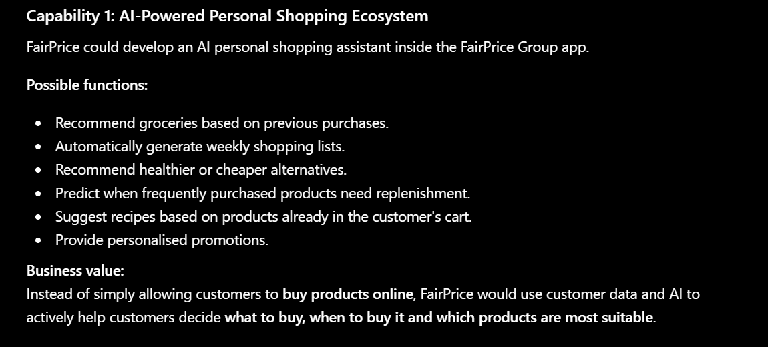
LO1 Activity – Digital Business Concepts

Slide 5
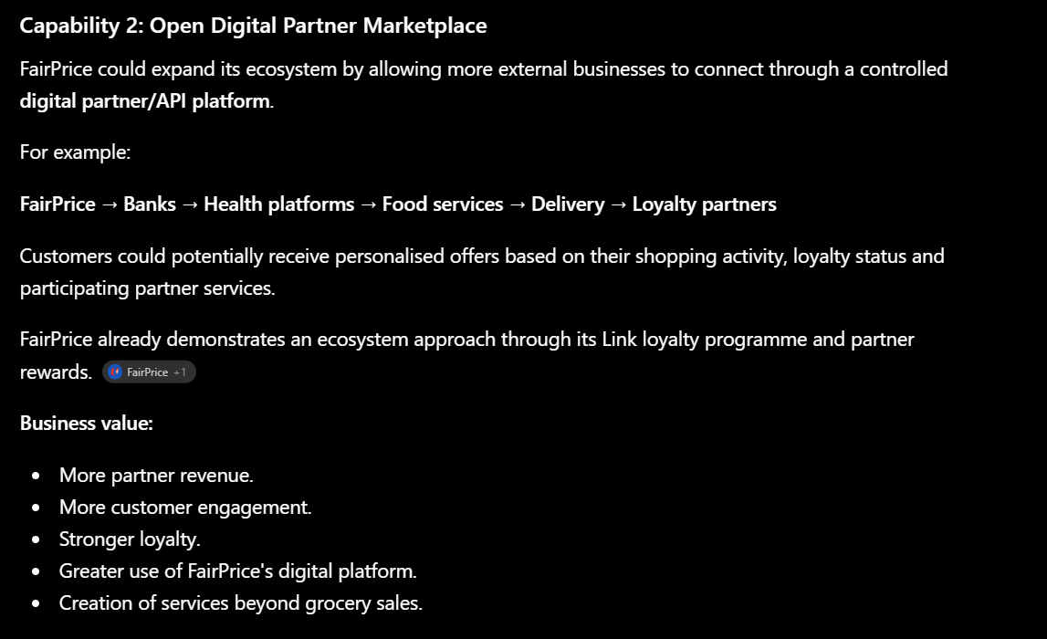
LO1 Activity – Digital Business Concepts

Slide 6
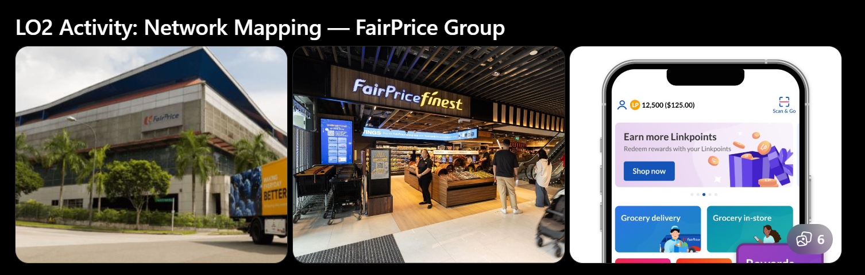
LO2 Activity: Network Mapping
It works particularly well because the company transition from a linear grocery supply chain to a multi-directional digital value network.
FairPrice works with more than 4,000 suppliers across over 40 countries and operates more than 600 stores, while its digital ecosystem connects customers, suppliers, partners, technology providers, loyalty services and digital platforms.

Slide 7
LO2 Activity: Network Mapping
Farmers / Manufacturers ↓
Suppliers
↓
FairPrice Distribution Centre
↓
FairPrice Supermarkets ↓
Customers
In the traditional model:
Suppliers/manufacturers provide food and consumer products.
Products are transported to FairPrice distribution facilities.
Products are distributed to physical FairPrice stores.
Customers purchase the products.
Customer feedback generally travels back through the retailer.
This is primarily a one-directional flow of products and information.
FairPrice's supplier network is substantial: the company states that it works with more than 4,000 suppliers from over 40 countries.

Slide 8
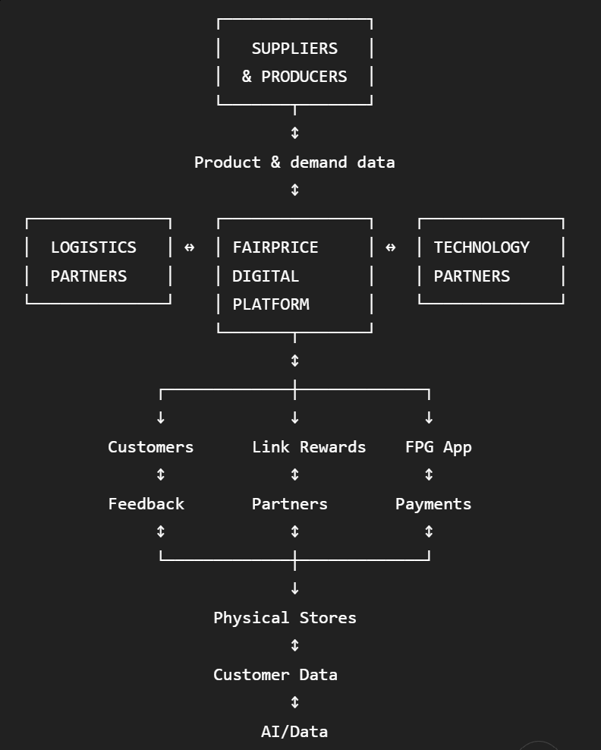
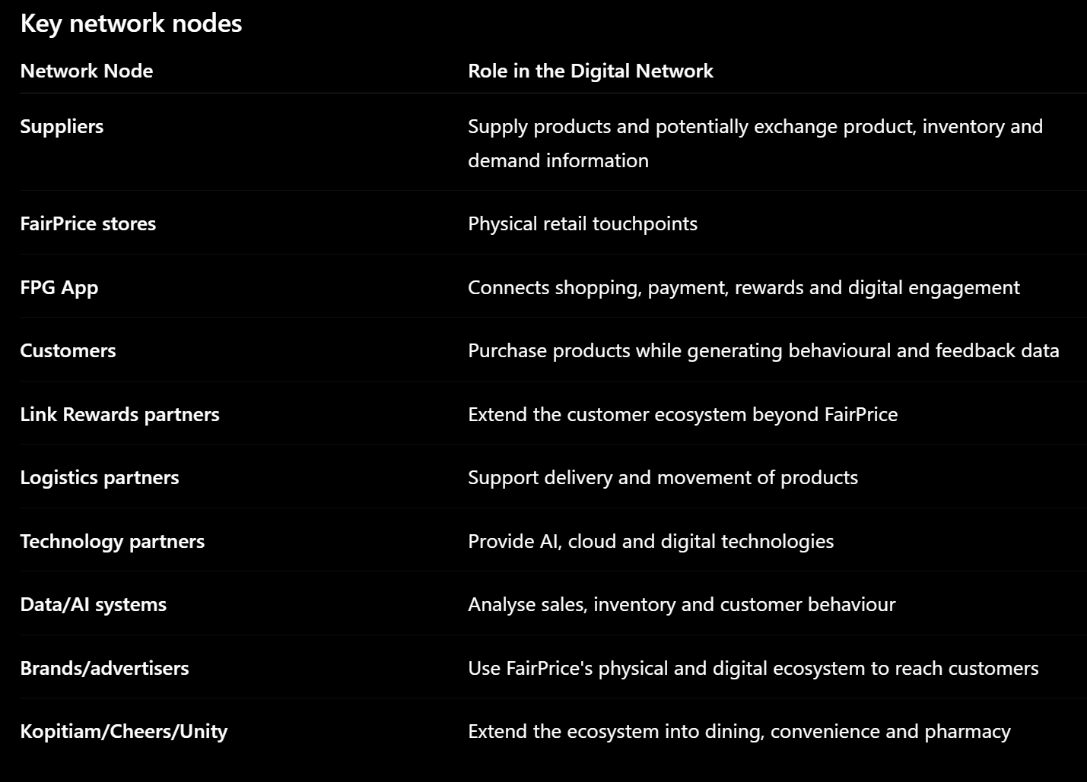
LO2 Activity: Network Mapping
FairPrice's Link Rewards network is a particularly good example of a multi-sided network: it has more than 2.4 million members and over 1,000 participating partner outlets. Customers can earn and redeem Linkpoints across participating businesses.

Slide 9
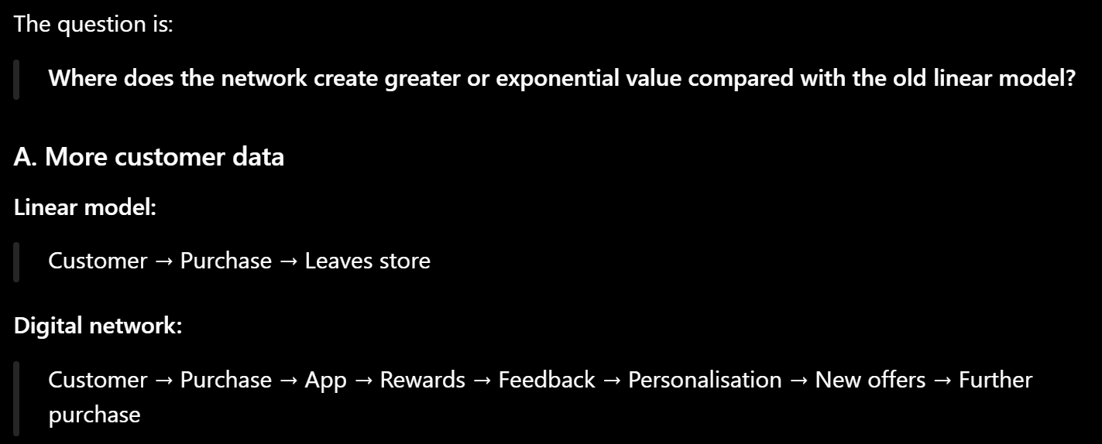
LO2 Activity: Network Mapping

Slide 10
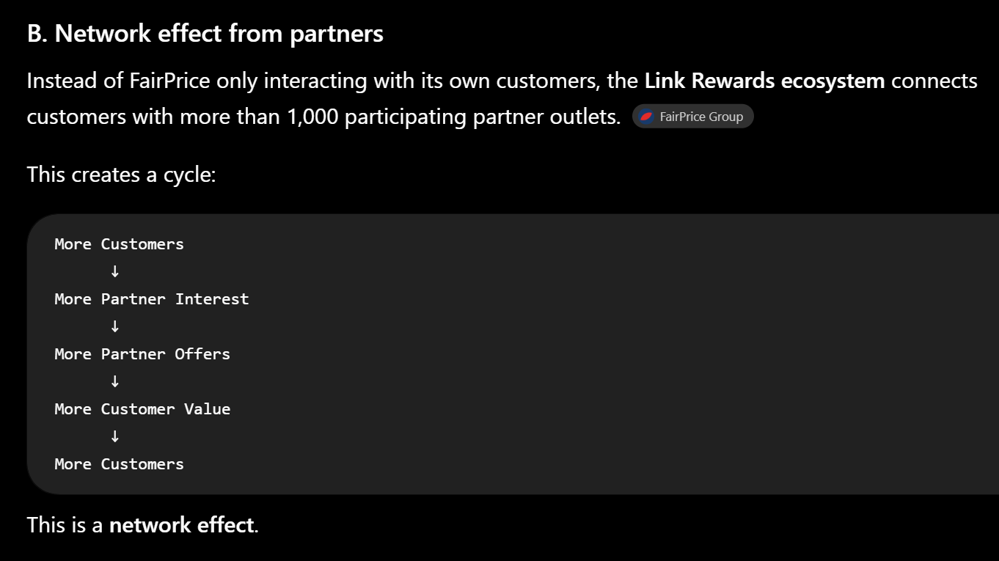
LO2 Activity: Network Mapping

Slide 11
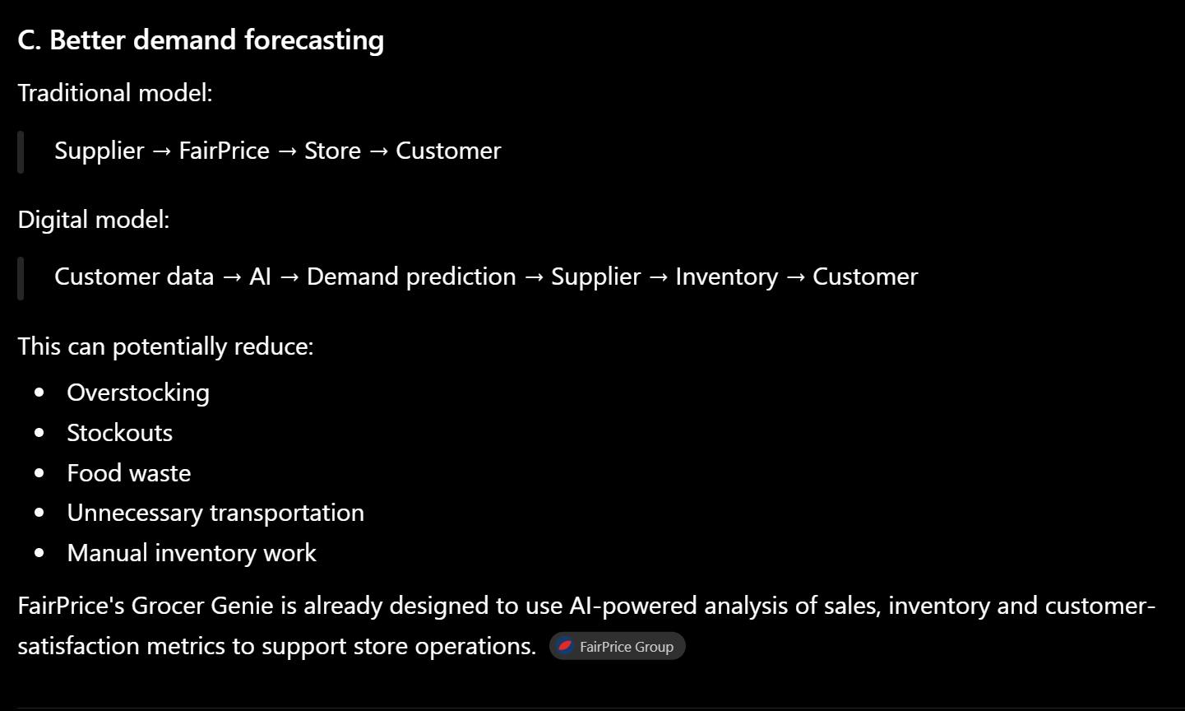
LO2 Activity: Network Mapping

Slide 12
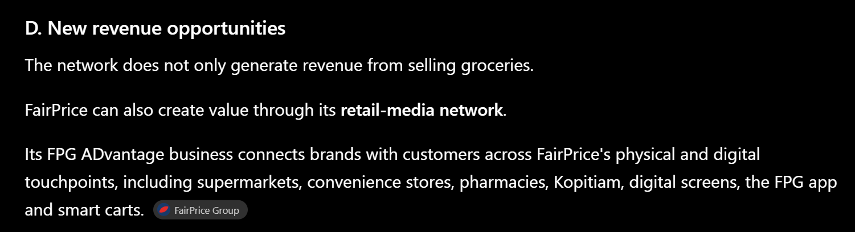
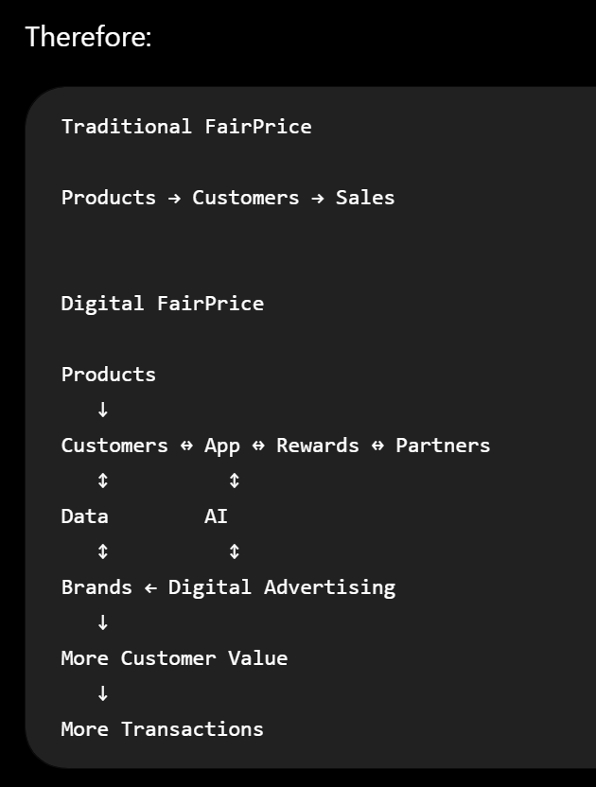
LO2 Activity: Network Mapping

Slide 13
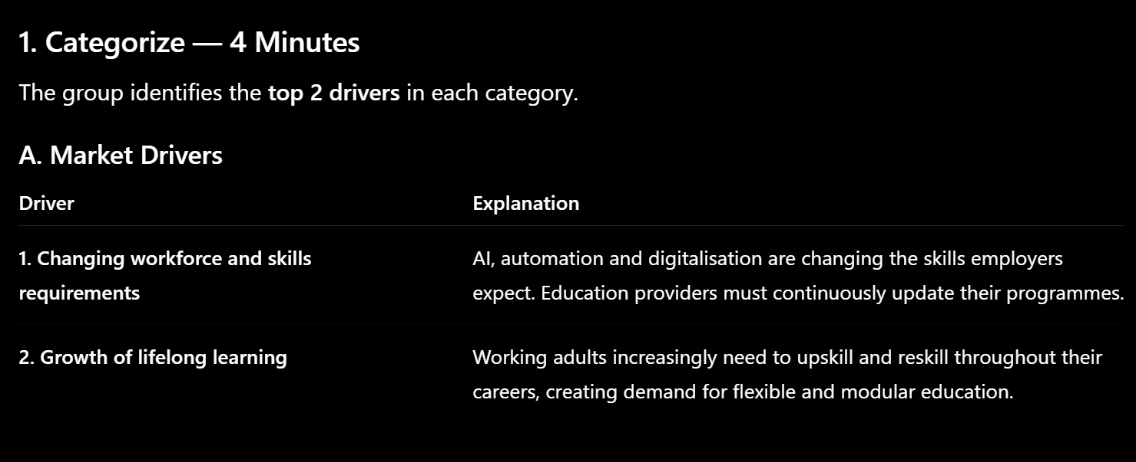
LO3: Activity – Digital Transformation

Slide 14
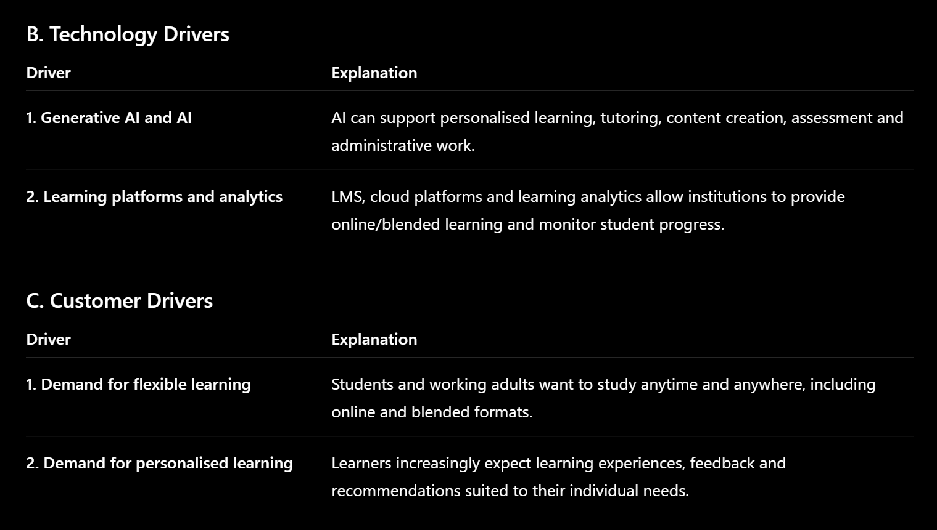
LO3: Activity – Digital Transformation

Slide 15
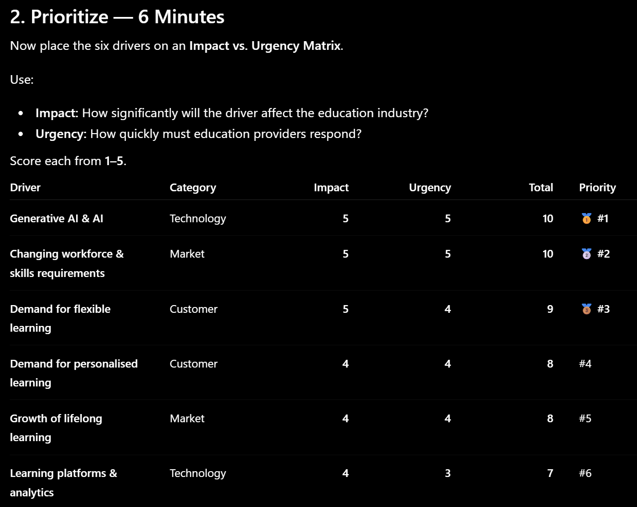
LO3: Activity – Digital Transformation

Slide 16
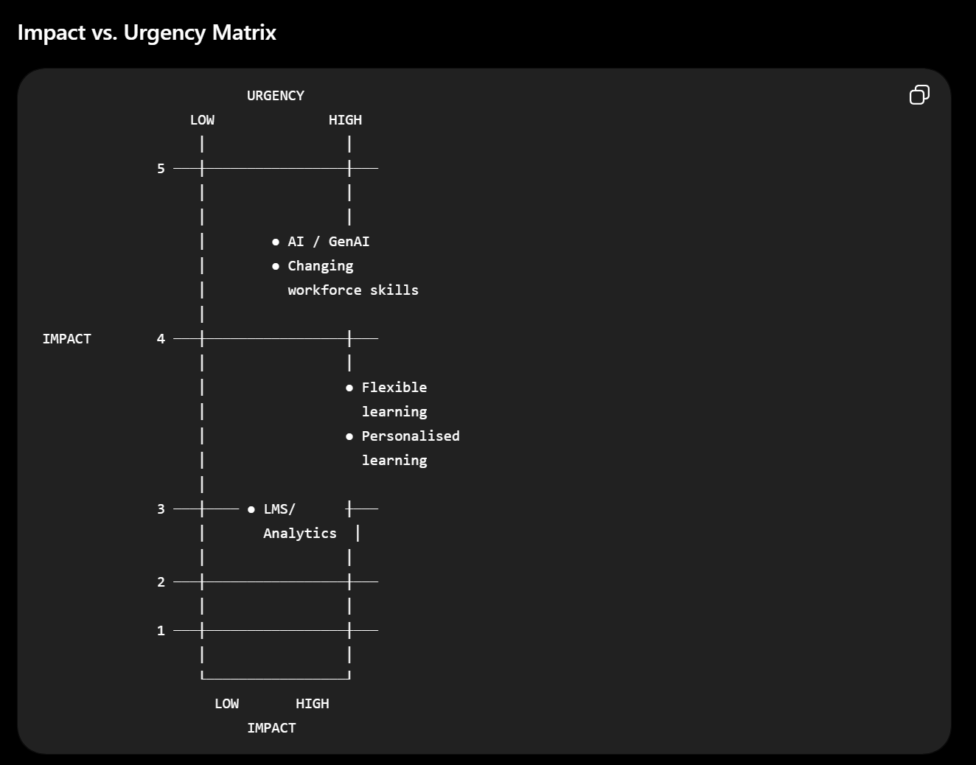
LO3: Activity – Digital Transformation
Strategic interpretation
The top-right quadrant represents drivers that have high impact and high urgency.
For Singapore education, the two most important immediate drivers are:
1. AI / Generative AI 2. Changing workforce and skills requirements
These should receive immediate strategic attention.

Slide 17
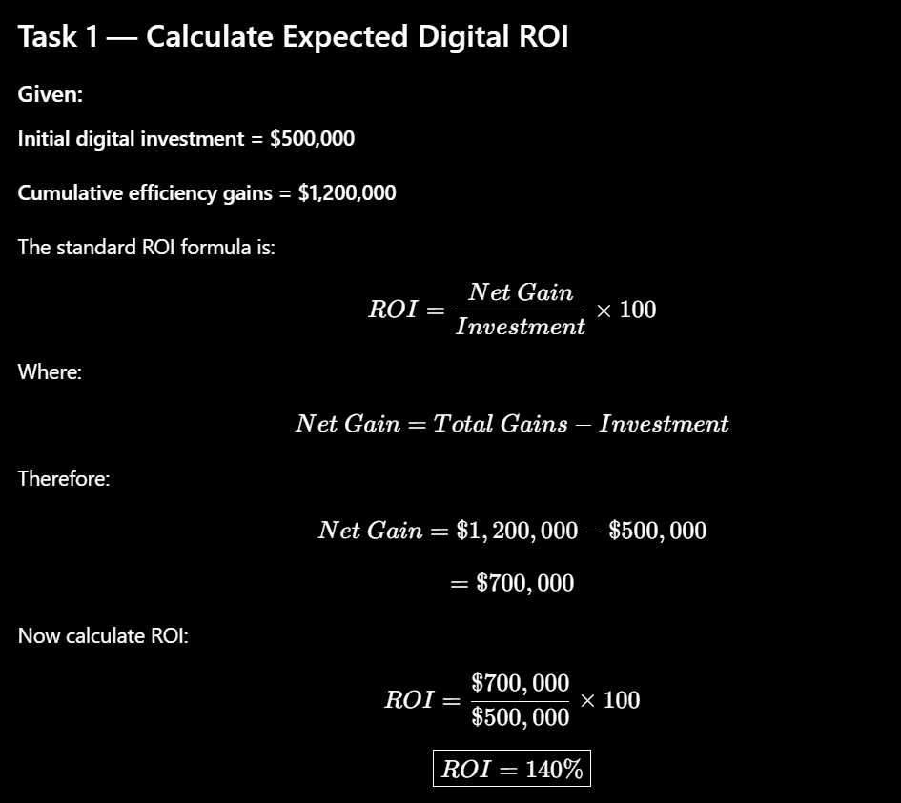
LO4: Activity – Strategic Alignment and ROI

Slide 18
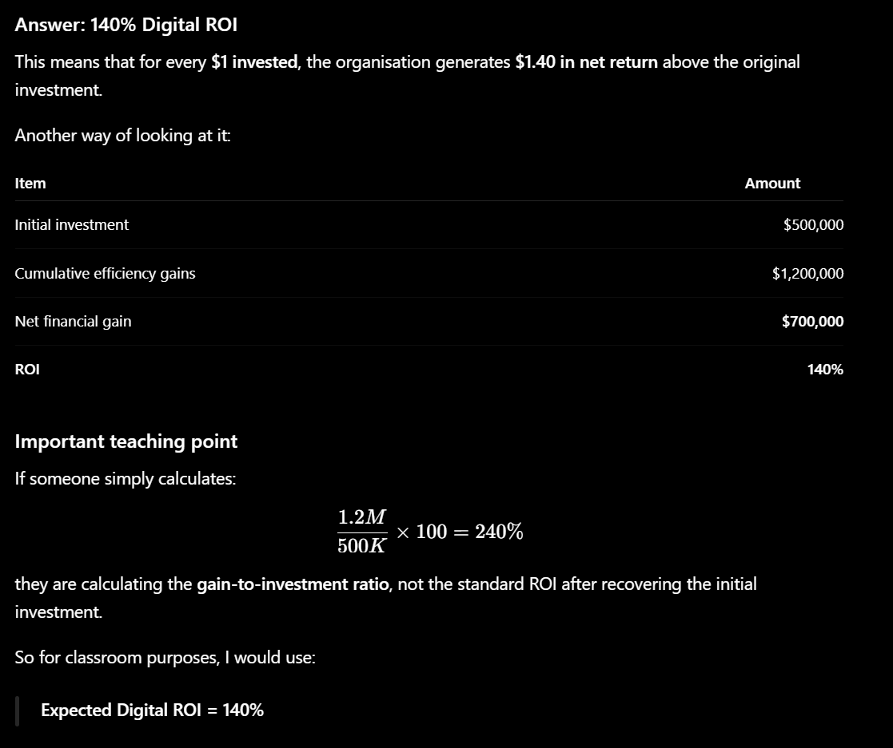
LO4: Activity – Strategic Alignment and ROI

Slide 19
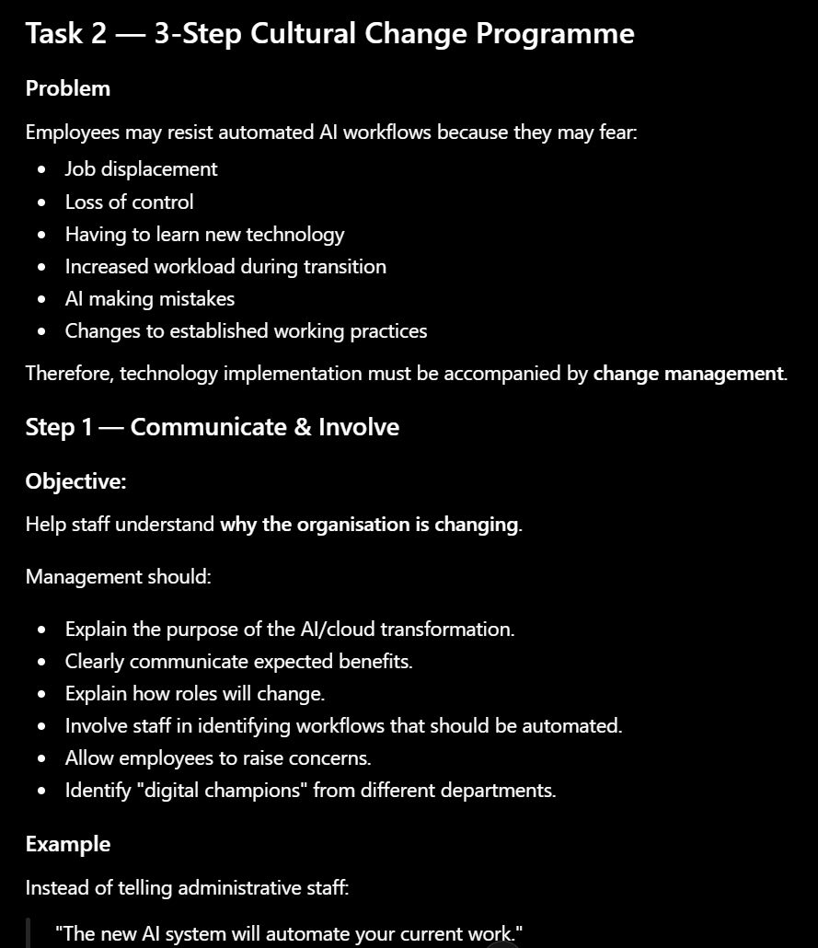
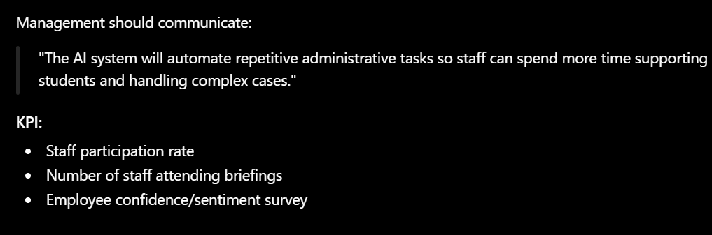
LO4: Activity – Strategic Alignment and ROI

Slide 20
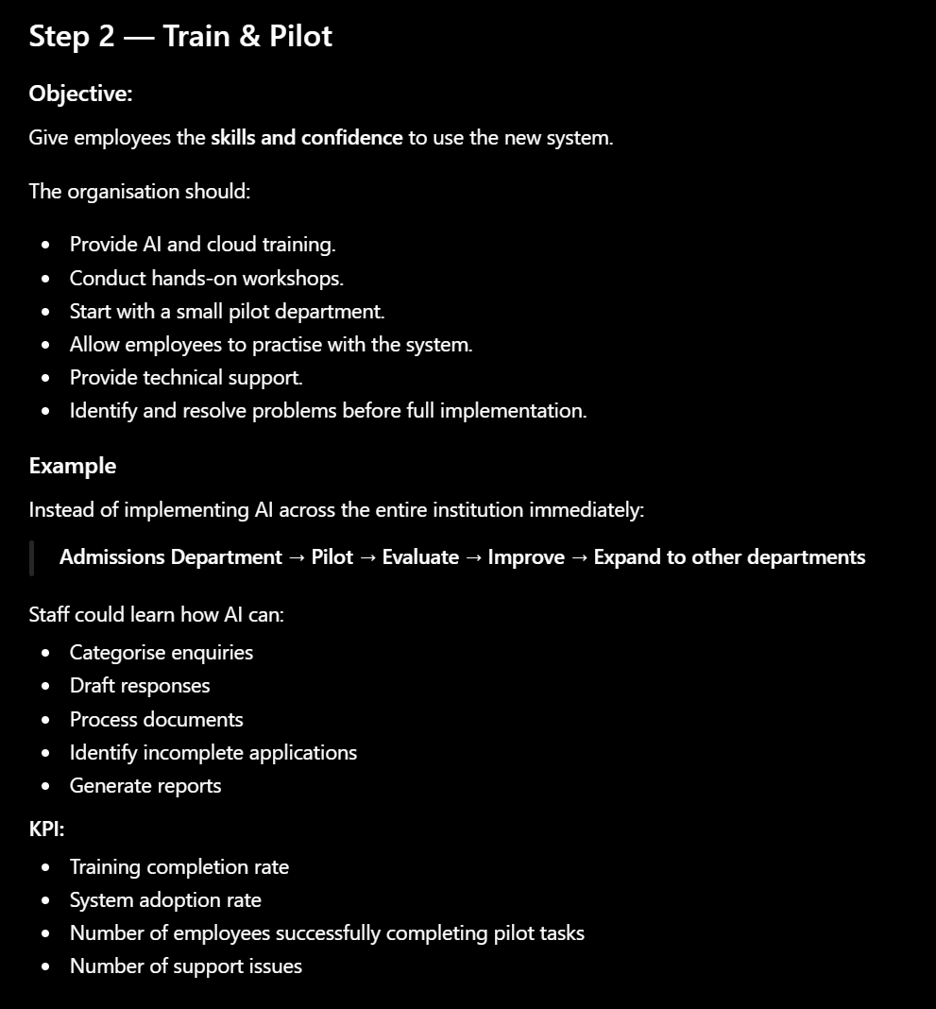
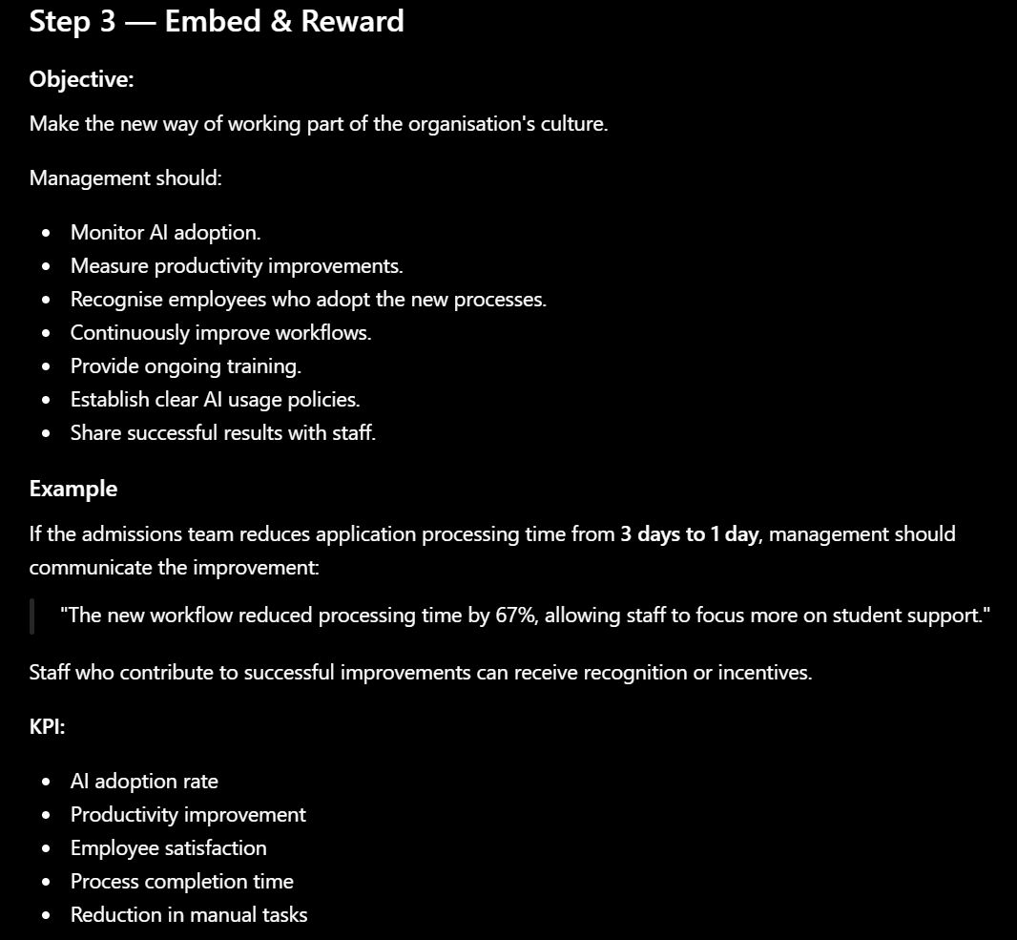
LO4: Activity – Strategic Alignment and ROI

Slide 21
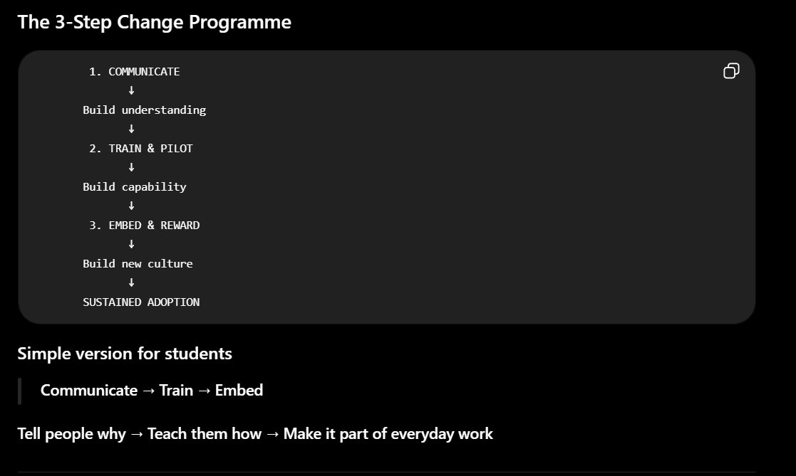
LO4: Activity – Strategic Alignment and ROI

Slide 22
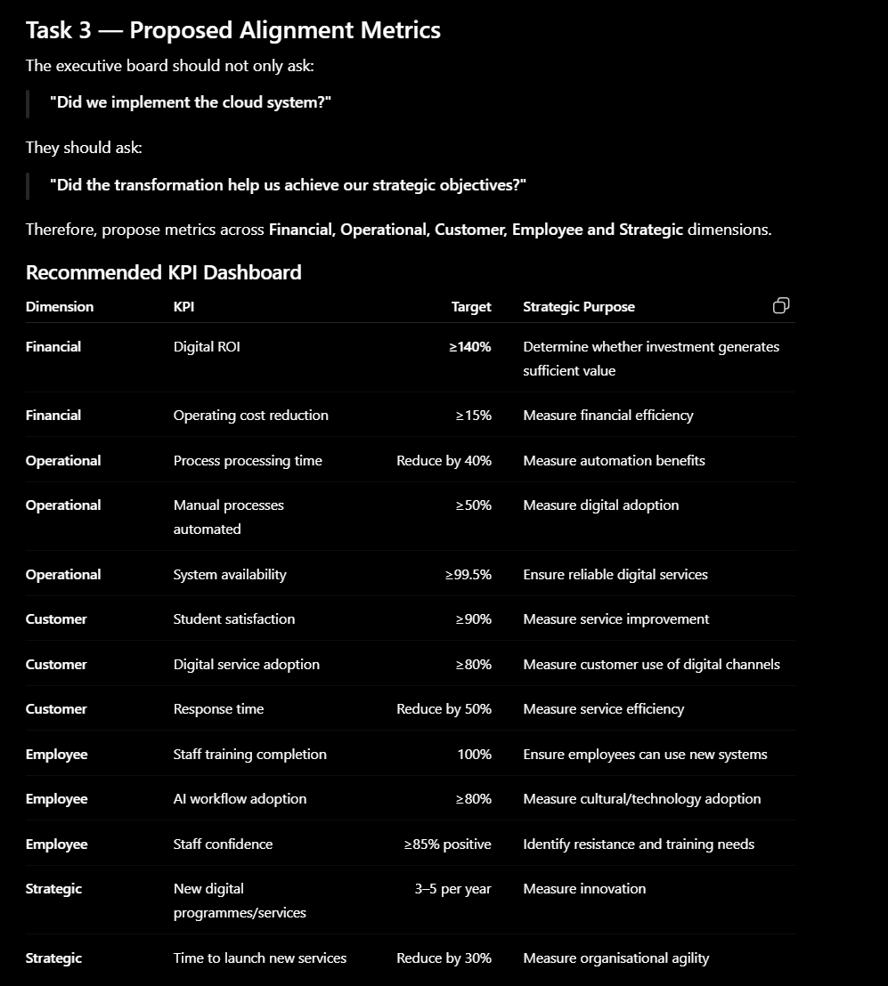
LO4: Activity – Strategic Alignment and ROI

